Slide 1

COVID-19 Transmission Network: Analyzing of GISAID Network Using Real Stories
CSC8550 Advanced Algorithms Project Presentation
Zafar Iqbal, Javad Rafiei Asl, Mokter Hossain

Slide 2
Outline
Introduction
Objective
Benchmark Dataset (Manual)
Sequenced data (GISAID)
Problem Definition and Formulation
Algorithms and Experiments
Source Code and Visualizations
Future Works
Reference

Slide 3
Introduction, Objective and Stories
By Mokter Hossain

Slide 4
COVID-19 Transmission Network
Introduction
Since mid-December of 2019, coronavirus disease 2019 (COVID-19) has been spreading from Wuhan, China.
As of today the COVID-19 has outbroken in about 200 countries of the world.
About 2.7M Cases with 200K death.

Slide 5
COVID-19 Transmission Network
Objective
To evaluate predicted transmission based on genome sequences using the actual stories to verify how COVID-19 outbreak occurred
We aims to peruse the three major facts:
Gathering sequences of transmission and stories behind them
Presenting an ILP to verify the predicated COVID-19 network
Designing two different algorithms to meet the devised ILP

Slide 6
The Manually Extracted Dataset (Stories)
More than 50 records are extracted from reliable and trusted resources
abcnews.com, cnn.com, nbcnews.com,
cdc.gov, scientific papers, etc.
ID | Source | Destination | Date
1 | China | Thailand | 1/13/2020
2 | China | Japan | 1/16/2020
3 | China | Japan | 1/20/2020
4 | China | Iran | 2/19/2020
5 | Japan | Israel | 2/21/2020
6 | UAE | Bahrain | 2/21/2020
7 | Italy | Algeria | 2/25/2020
8 | Japan | Indonesia | 3/2/2020
9 | Italy | Jordan | 3/2/2020
10 | Iran | Latvia | 3/2/2020
11 | Iran | Saudi Arabia | 3/2/2020

Slide 7
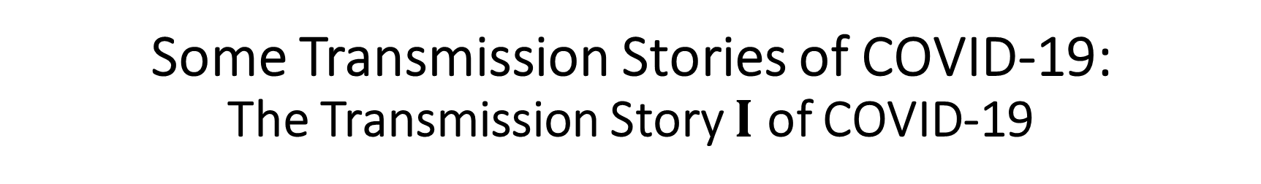
Some Transmission Stories of COVID-19: The Transmission Story $Ι$ of COVID-19
On 31 December 2019, Wuhan CDC admitted that there was a cluster of unknown pneumonia cases related to Huanan Seafood Market in Wuhan, the capital of Hubei province, China.

Slide 8
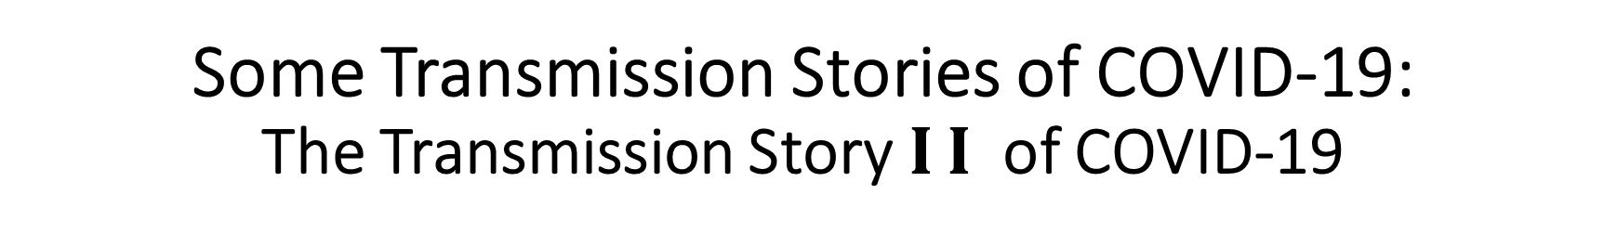
Some Transmission Stories of COVID-19: The Transmission Story$Ι$ $Ι$of COVID-19
On 16 January 2020, coronavirus pandemic was confirmed to have spread to Japan from China in a person who traveled to Wuhan, China.

Slide 9
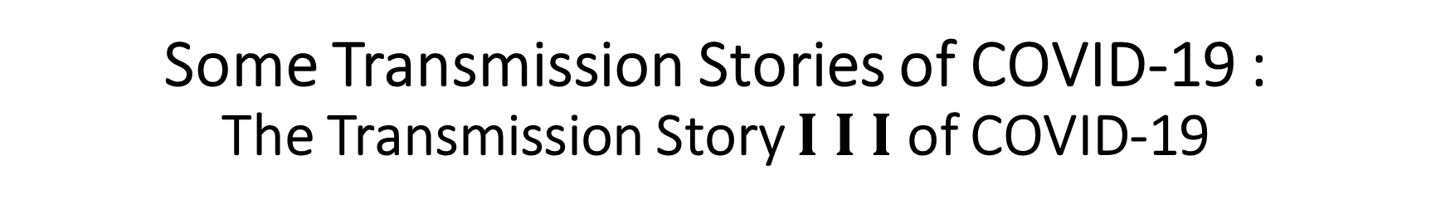
Some Transmission Stories of COVID-19 : The Transmission Story $Ι$ $Ι Ι$of COVID-19
On January 19, 2020, coronavirus pandemic was confirmed to be spread in the United States by a 35-year-old man who returned to Kirkland, WA, United State on January 15 after traveling to visit family in Wuhan, China.

Slide 10
GISAID COVID-19 Data, Problem Definition and Formulation
By Zafar Iqbal

Slide 11
Genetic sequences
Genetic sequence data from pathogens presents a novel means to investigate the spread of infectious disease between infected hosts.
The objective is to recover the epidemic transmission tree, which identifies who infected whom.
On the basis of difference between sequences and other factors (recombination and convergent evolution), the transmission tree could be predicted.

Slide 12
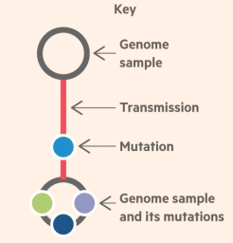
Virus mutation
A virus spreads by rapidly replicating many times within its host.
Transmission to a new hosts also occurs by the replication
The rapid replication results in copying mistakes.
Miner changes in their genetic code. (mutations)
Coronavirus mutates almost twice a month.

Slide 13
Coronavirus Genome Sequences
Scientists studying mutations in coronavirus have decoded more than 10,000 different genomes of the deadly pathogen.
Creates a comprehensive map that will be crucial to controlling the pandemic and developing medicines to treat it.

Slide 14
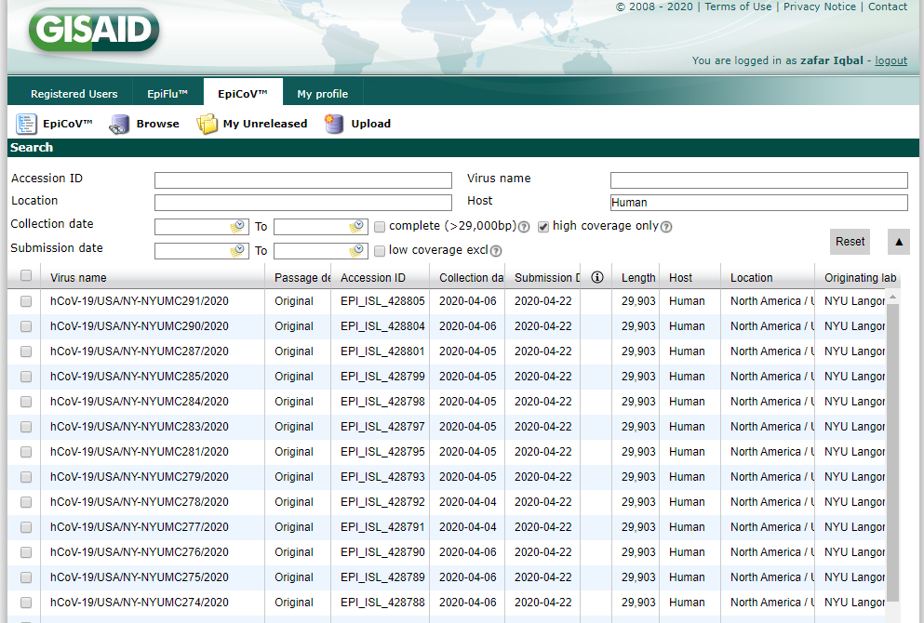
GISAID Dataset

Slide 15
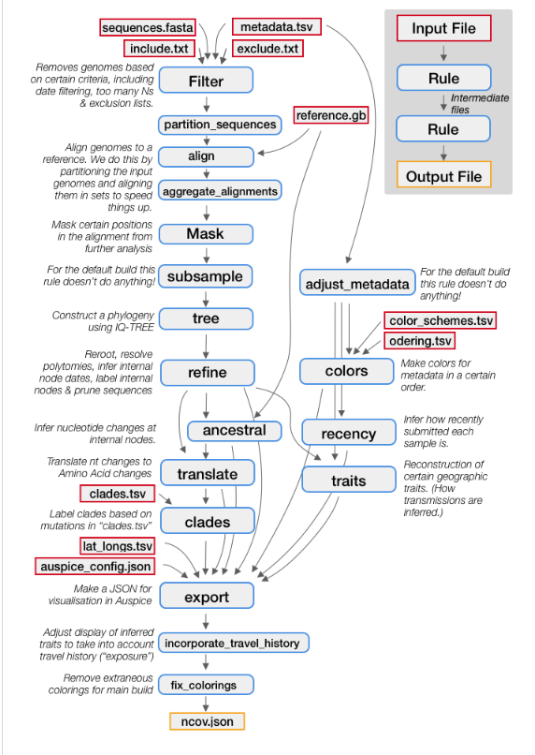
The Nextstrain’s Augur toolkit: how to get GISAID transmissions
Bioinformatics' toolkit used to analyze different pathogens (viruses).
The data undergoes different steps to get transmissions:
Filter the sequences
Align the sequences
Construct the phylogeny (tree)
Get a Time-Resolved Tree
Identify Amino-Acid Mutations
Json file containing predicted information about GISAID transmission.

Slide 16
Transmission Graph
a
c
d6
d2
d1
d8
d3
d7
b
d
d4
d5
e
A n$ode refers to a country$
$An edge refers to a transmission from one contry to another in one specific date$

Slide 17



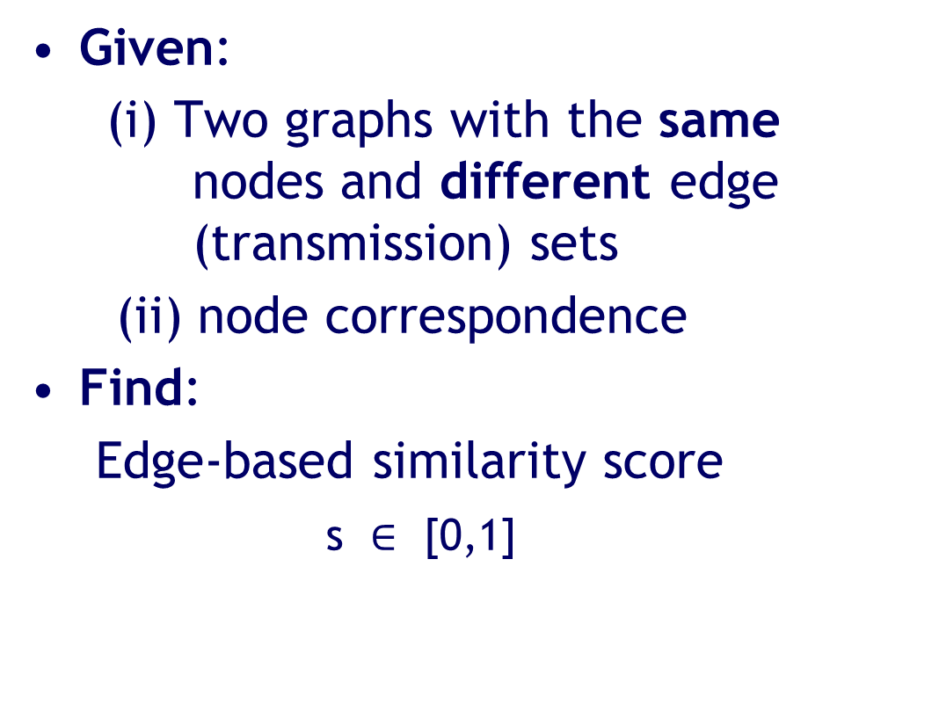
Problem Definition: Known Node Correspondence
G_{A}
Given:
(i) Two graphs with the same nodes and different edge (transmission) sets
(ii) node correspondence
Find:
Edge-based similarity score
s $∈$ [0,1]
G_{B}
s = 0: G_{A} <> G_{B}
s = 1: G_{A} == G_{B}

Slide 18
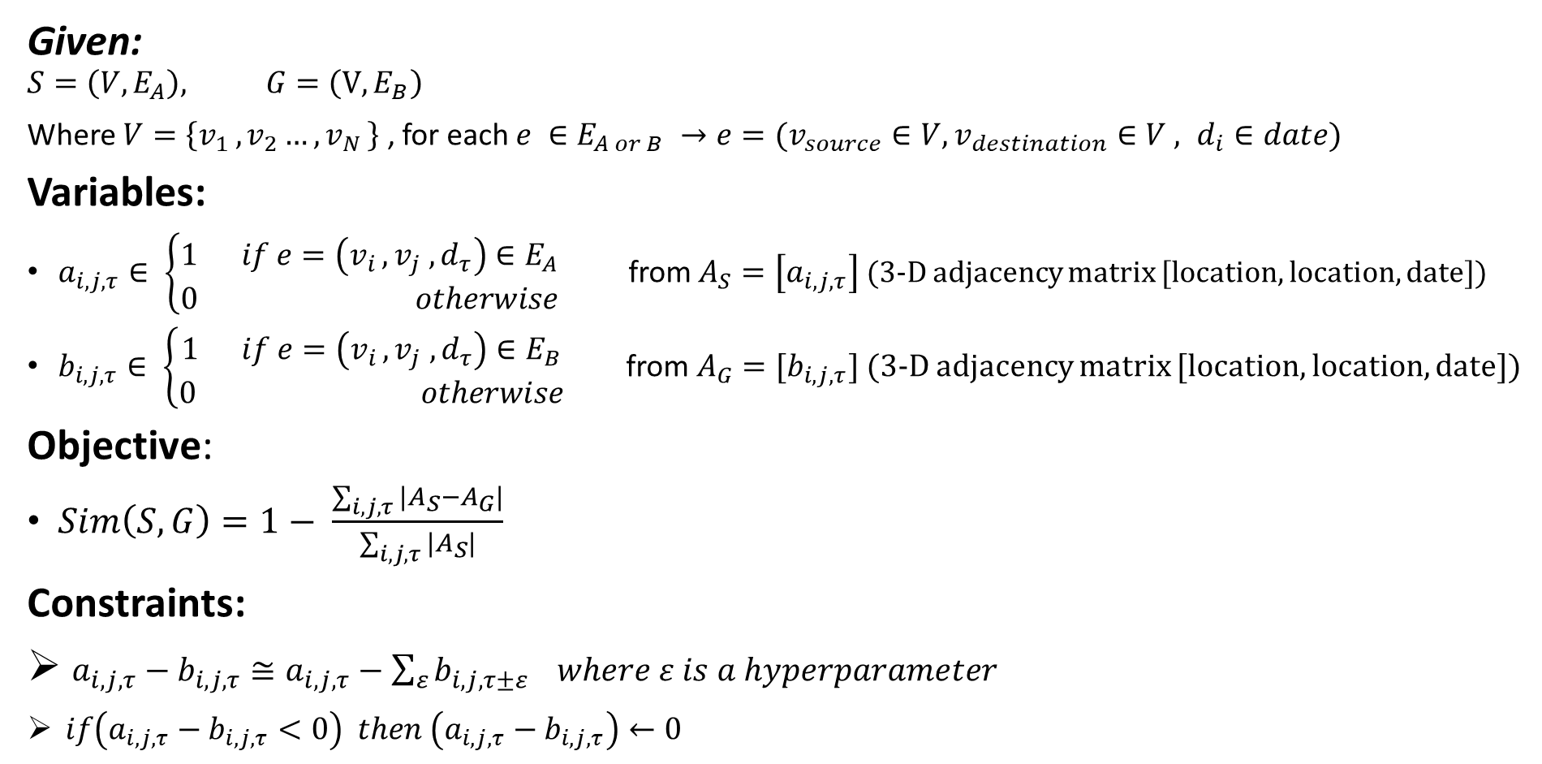
Problem Formulation (ILP)
Given:
$$S=\left(V,E_{A}\right), G=\left(V,E_{B}\right)$$
Where $V=\left\{v_{1 },v_{2}…,v_{N }\right\}$ , for each $e ∈E_{A or B} →e=(v_{source}∈V,v_{destination}∈V , d_{i}∈date)$
Variables:
$a_{i, j, τ}∈ \left\{\begin{aligned}1 if e=\left(v_{i },v_{j} ,d_{τ}\right)∈E_{A} \\ 0 otherwise\end{aligned}\right.$ from $A_{S}=\left[a_{i, j, τ}\right]$ (3-D adjacency matrix [location, location, date])
$b_{i, j, τ}∈ \left\{\begin{aligned}1 if e=\left(v_{i },v_{j} ,d_{τ}\right)∈E_{B} \\ 0 otherwise\end{aligned}\right. \text{from} A_{G}=[b_{i, j, τ}]$ (3-D adjacency matrix [location, location, date])
Objective:
$Sim\left(S, G\right)=1− \frac{\sum_{i,j,τ}{|A_{S}−A_{G}|}}{\sum_{i,j, τ}{|A_{S}|}}$
Constraints:
$a_{i, j, τ}−b_{i, j, τ}≅a_{i, j, τ}−\sum_{ε}{b_{i, j, τ±ε}} where ε is a hyperparameter$
$if\left(a_{i, j, τ}−b_{i, j, τ}<0\right) then \left(a_{i, j, τ}−b_{i, j, τ}\right)←0$

Slide 19
Algorithms and Experiments
By Javad Rafiei Asl

Slide 20
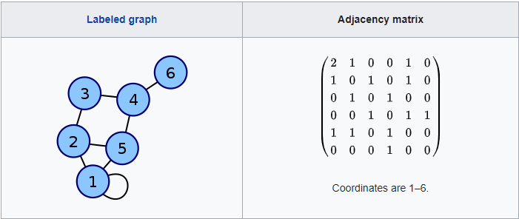
Adjacency Matrix
An adjacency matrix is a square matrix used to represent a finite graph.
The elements of the matrix indicate whether pairs of vertices are adjacent or not in the graph.

Slide 21
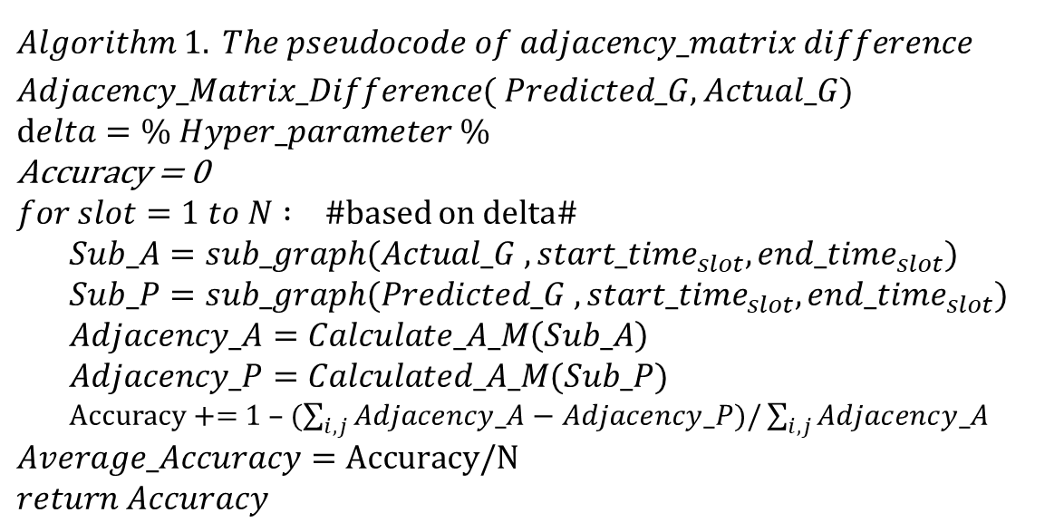
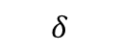
Adjacency Matrix Difference Algorithm
$$Algorithm 1. The pseudocode of adjacency_matrix difference$$
$Adjacency_Matrix_Difference( Predicted_G, Actual_G)$
$$delta=\% Hyper_parameter \%$$
$$\text{Accuracy}\text{ = 0}$$
$for slot=1 to N : \#$based on delta#
$Sub_A=sub_graph(Actual_G , {start_time}_{slot}, {end_time}_{slot})$
$$Sub_P=sub_graph(Predicted_G , {start_time}_{slot}, {end_time}_{slot})$$
$Adjacency_A=Calculate_A_M\left(Sub_A\right)$
$$Adjacency_P=Calculated_A_M(Sub_P)$$
Accuracy += 1 – ($\sum_{i,j}{Adjacency_A−Adjacency_P})/\sum_{i,j}{Adjacency_A}$
$$Average_Accuracy=\text{Accuracy}\text{/}\text{N}$$
$$return Accuracy$$
. . . .
slot1
slot2
slotN
$$δ$$
Actual Trans
Predicted Trans
Time

Slide 22

Experiment for Algorithm-1
. . . .
slot1
slot2
slotN
$$δ$$
Actual Trans
Predicted Trans
Time

Slide 23
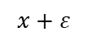
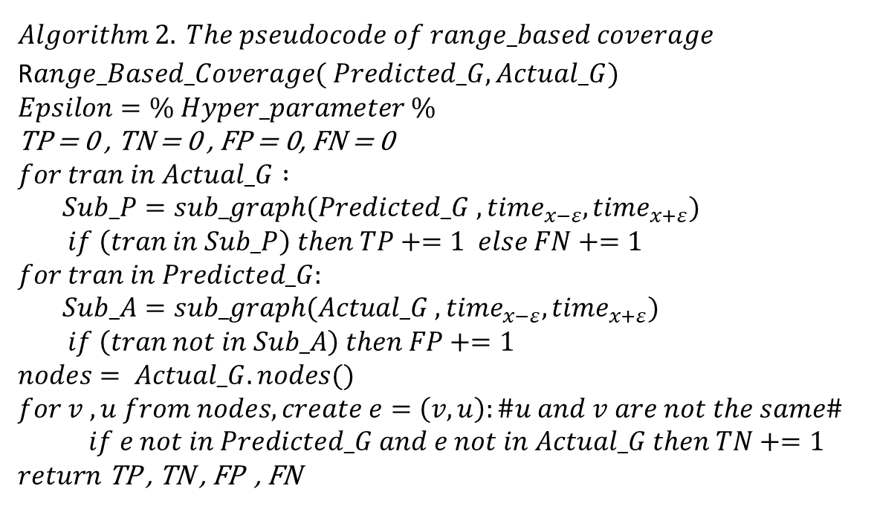
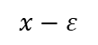
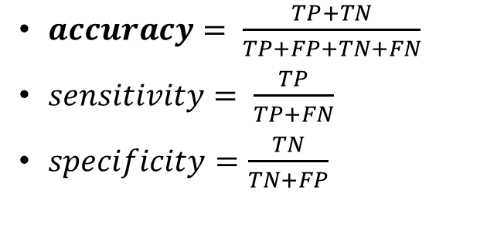
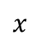


Range Based Coverage Algorithm
$$Algorithm 2. The pseudocode of range_based coverage$$
R$ange_Based_Coverage( Predicted_G, Actual_G)$
$$Epsilon=\% Hyper_parameter \%$$
$$\text{TP}\text{ = 0}\text{ , }\text{TN}\text{ = 0 , }\text{FP}\text{ = 0, }\text{FN}\text{ = 0 }$$
$$for tran in Actual_G :$$
$Sub_P=sub_graph(Predicted_G , {time}_{x−ε}, {time}_{x+ε})$
$if \left(tran in Sub_P\right) then TP+=1 else FN+=1$
$$for tran in Predicted_G:$$
$Sub_A=sub_graph(Actual_G , {time}_{x−ε}, {time}_{x+ε})$
$if \left(tran not in Sub_A\right) then FP+=1$
$$nodes= Actual_G.nodes()$$
$$for v , u from nodes, create e=\left(v,u\right):\#u and v are not the same\#$$
$if e not in Predicted_G and e not in Actual_G then TN+=1$
$$return \text{TP}\text{ , }\text{TN}\text{ , }\text{FP}\text{ , }\text{FN}$$
$$x−ε$$
$$x$$
$$x+ε$$
$$ε$$
$$ε$$
Actual Trans
Predicted Trans
Time
$accuracy= \frac{TP+TN}{TP+FP+TN+FN}$
$sensitivity= \frac{TP}{TP+FN}$
$specificity=\frac{TN}{TN+FP}$
Predicted
 | Positive | Negative
Positive | TP | FN
Negative | FP | TN
Actual

Slide 24
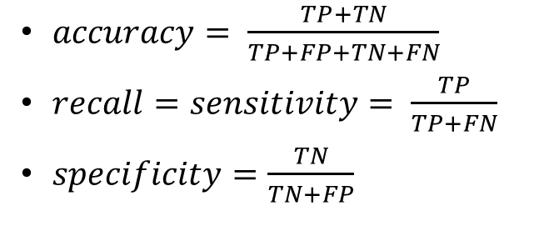
Experiment for Algorithm-2
$$x−ε$$
$$x$$
$$x+ε$$
$$ε$$
$$ε$$
Actual Trans
Predicted Trans
Time
$accuracy= \frac{TP+TN}{TP+FP+TN+FN}$
$recall=sensitivity= \frac{TP}{TP+FN}$
$specificity=\frac{TN}{TN+FP}$

Slide 25
Implementation Source code & Visualization
Source code on GitHub: https://github.com/jasl1/Covid-19-transmission-network
Visualization Results for weekly snapshots: https://github.com/jasl1/Covid-19-transmission-network/tree/master/sample%20output

Slide 26
Future Work
Improving benchmark dataset by crawling news and scientific papers
Designing more complicated algorithms
Such as DeltaCon and CutDistance
Comparing our approach with other state-of-the-art methods
Using different measurements
Exploring other epidemical repositories to find more predictions
Based on different alignment algorithms

Slide 27
References:
https://www.sciencedirect.com/science/article/pii/
https://en.wikipedia.org/wiki/Coronavirus_disease_2019
https://abcnews.go.com/Health/timeline-coronavirus-started/story?id=69435165
https://en.wikipedia.org/wiki/2019%E2%80%9320_coronavirus_pandemic_by_country_and_territory
https://www.npr.org/sections/goatsandsoda/2020/03/30/822491838/coronavirus-world-map-tracking-the-spread-of-the-outbreak

